Slide 1
CIS 4930-001: Introduction to Augmented and Virtual Reality
Display Technologies

Slide 2

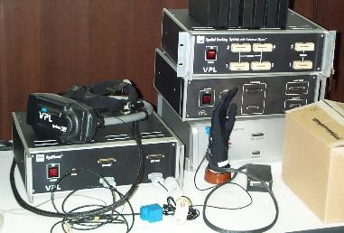
Motivation
Understand: In order to create a strong sense of Presence we need to understand the Human Perception system
Stimulate: We need to be able to use technology to provide real world sensory inputs, and create the VR illusion
VR Hardware
Human Senses

Slide 3

Senses
How an organism obtains information for perception:
Sensation part of Somatic Division of Peripheral Nervous System
Integration and perception requires the Central Nervous System
Five major senses:
Sight (Opthalamoception)
Hearing (Audioception)
Taste (Gustaoception)
Smell (Olfacaoception)
Touch (Tactioception)

Slide 4
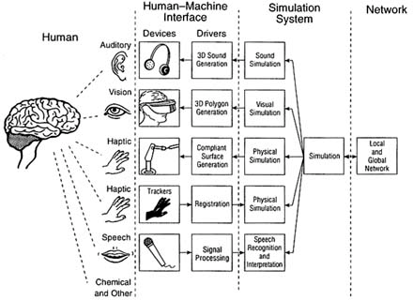
Using Technology to Stimulate Senses
Simulate output
E.g. simulate real scene
Map output to devices
Graphics to HMD
Use devices to stimulate the senses
HMD stimulates eyes

Slide 5
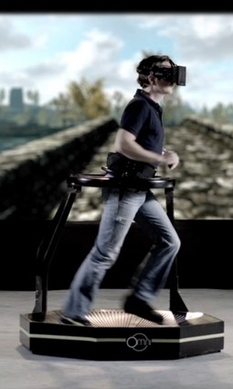
Key Technologies for VR System
Visual Display (this lecture)
Stimulate visual sense
Audio/Tactile/Other (later on)
Stimulate hearing/touch
Tracking (later on)
Changing viewpoint
User input
Input Devices (later on)
Supporting user interaction

Slide 6
Properties of the Human Visual System
visual acuity: 20/20 is ~1 arc min
field of view: ~200° monocular, ~120° binocular, ~135° vertical
resolution of eye: ~576 megapixels
temporal resolution: ~60 Hz (depends on contrast, luminance)
dynamic range: instantaneous 6.5 f-stops, adapt to 46.5 f-stops
color: everything in CIE diagram
accommodation range: ~8cm to ∞, degrades with age

Slide 7

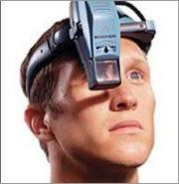
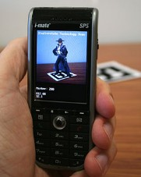
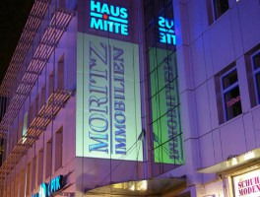
Creating an Immersive Experience
Head Mounted Display (HMD)
Immerse the eyes
Handheld
Lightweight, dynamic, and interactive
Projection/Large Screen
Immerse the body
Modify the space

Slide 8
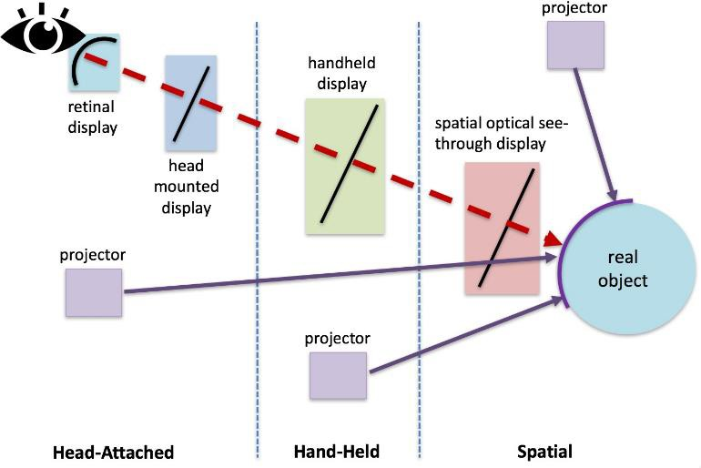
Display Taxonomy
Bimber, O., & Raskar, R. (2005). Spatial augmented reality: merging real and virtual worlds. CRC press.

Slide 9
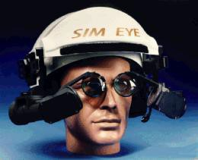
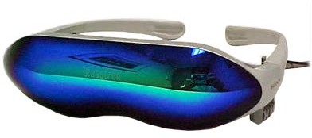
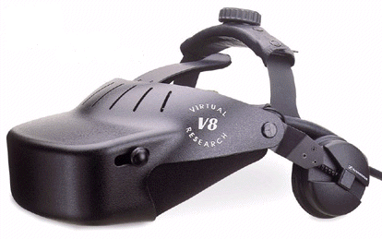
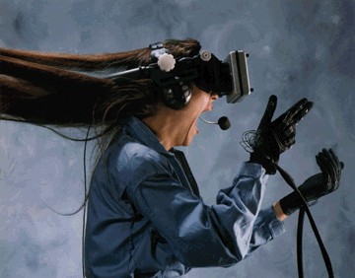
Key Properties of HMDs
Lens
Focal length, Field of View
Occularity, Interpupillary distance
Eye relief, Eye box
Display
Resolution, contrast
Power, brightness
Refresh rate
Ergonomics
Size, weight, wearability

Slide 10
Focal Distance
Optics between the image plane and the user’s eye produce a virtual image farther away from the eye
Reduces accommodative effort
Ideally out a few meters to help cancel convergence/accommodative rivalry
Optics magnify pixel granularity!
focus distance
virtual image
screen
eye
optics

Slide 11


Field of View
Monocular FOV is the angular subtense (usually expressed in degrees) of the displayed image as measured from the pupil of one eye.
Total FOV is the total angular size of the displayed image visible to both eyes.
Binocular (or stereoscopic) FOV refers to the part of the displayed image visible to both eyes.
FOV may be measured horizontally, vertically or diagonally.

Slide 12

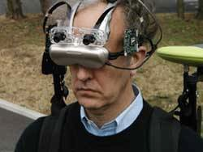
Ocularity
Monocular - HMD image to only one eye.
Bioccular - Same HMD image to both eyes.
Binocular (stereoscopic) - Different but matched images to each eye.

Slide 13
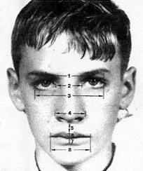
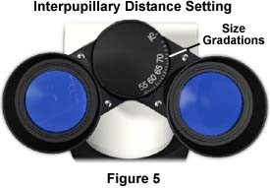
Interpupillary Distance (IPD)
IPD is the horizontal distance between a user's eyes.
IPD is the distance between the two optical axes in a binocular view system.

Slide 14

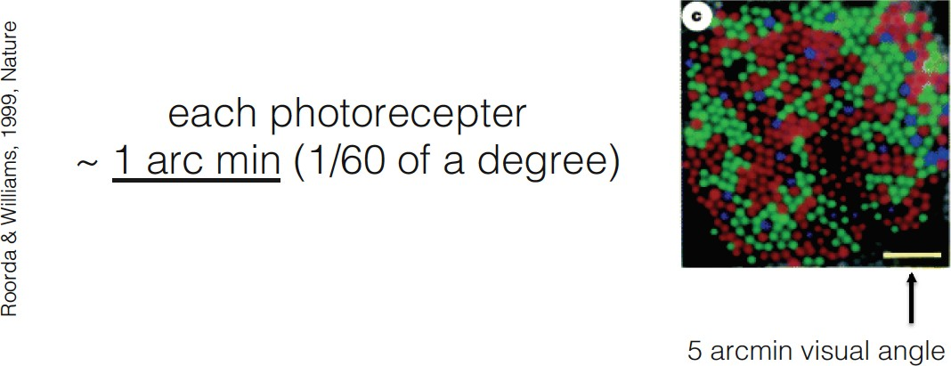
Visual Acuity
Ability to resolve details
Several types of visual acuity
detection, separation, etc.
Normal eyesight can see a US quarter at 275 ft
Corresponds to 1 arc min (1/60th of a degree)
Max acuity = 0.4 arc min
Visual Acuity Test Targets

Slide 15
Distortion in Lens Optics
HMD optics distort images shown in them
A rectangle
Maps to this

Slide 16
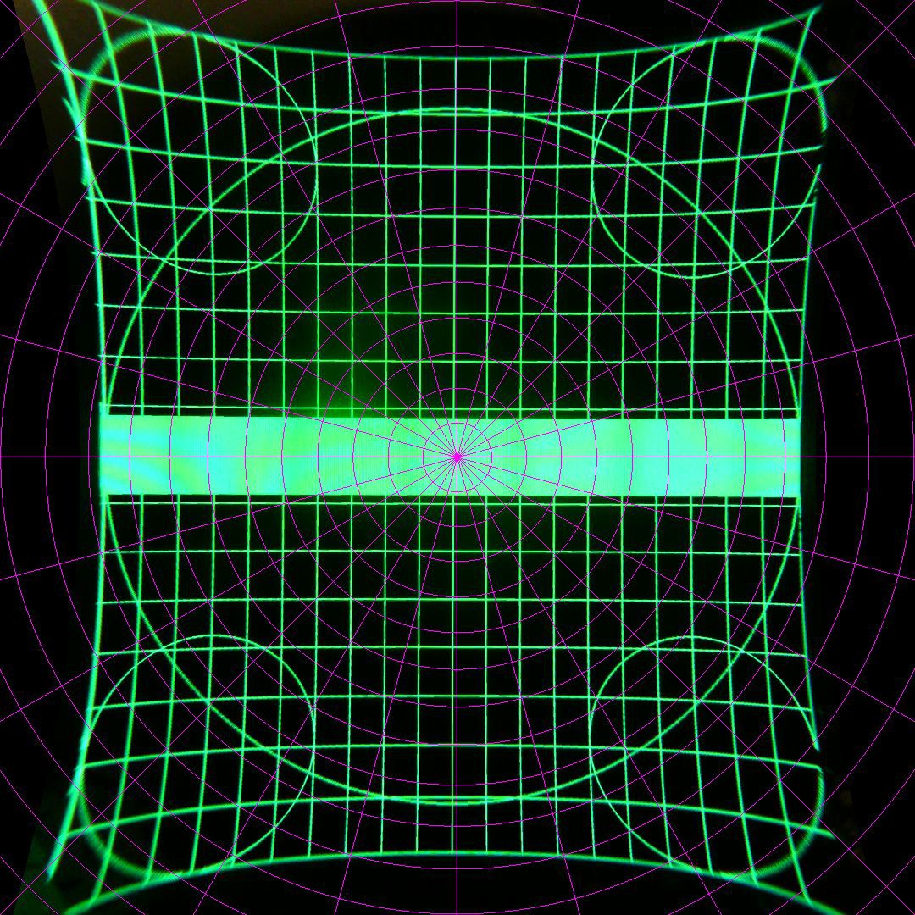

Example Distortion
Oculus Rift DK2
HTC Vive

Slide 17
To Correct for Distortion
Must pre-distort image
This is a pixel-based distortion
Use shader programming

Slide 18
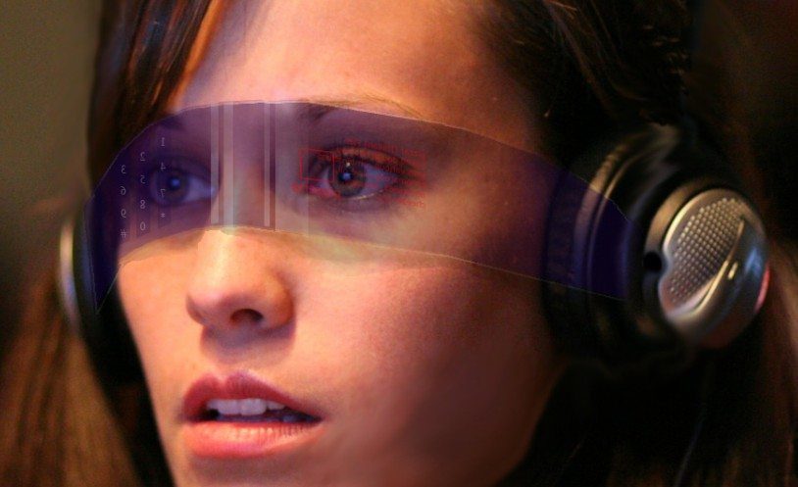
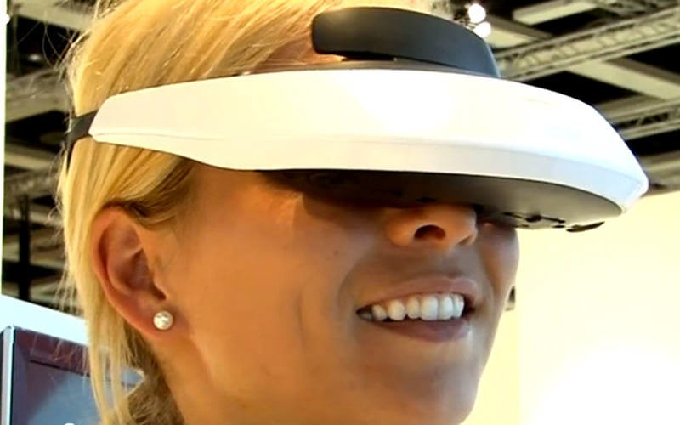
HMD Design Trade-offs
Resolution vs. field of view
As FOV increases, resolution decreases for fixed pixels
Eye box vs. field of view
Larger eye box limits field of view
Size, Weight, and Power vs. everything else
vs.

Slide 19
3 Types of Head Mounted Displays
Occluded
See-thru
Multiplexed

Slide 20
VR Only HMD
Monitors
Graphics

Slide 21
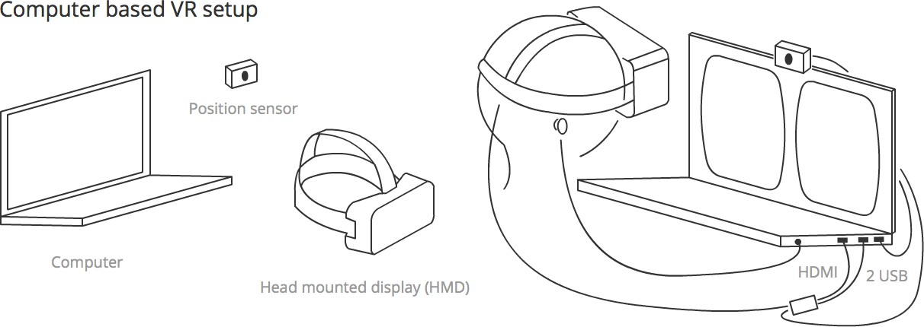
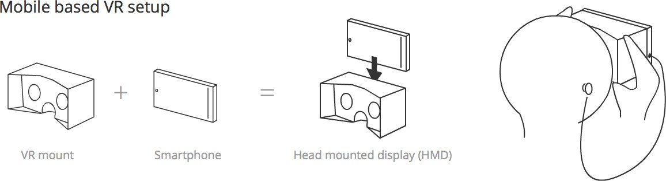
Computer Based vs. Mobile VR Displays

Slide 22
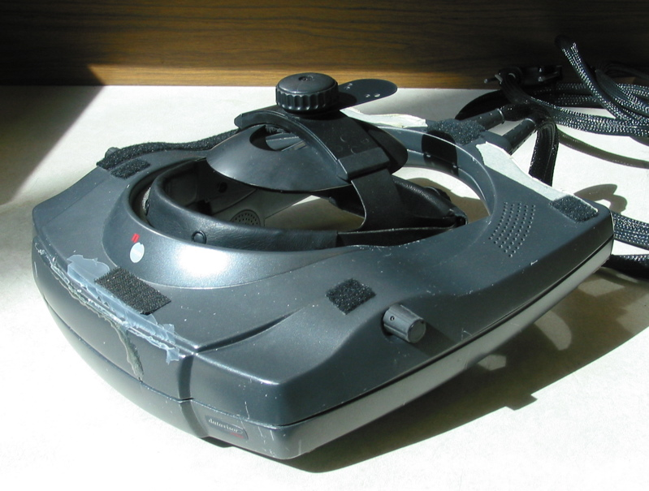
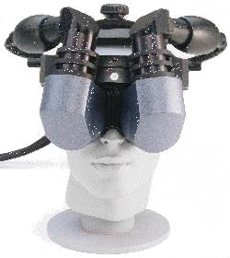
Good Ol’ Days: CRT-based HMD
Datavisor HiRes: 1280x1024, 1.9’/pixel, 42° fov (100% overlap), about 4lbs, uses monochrome CRT w/ color filter shutters
Datavisor 80: 1280x1024, 3’/pixel, accommodation at infinity, 80° diagonal fov, 120° with 20% overlap, about 5lbs

Slide 23
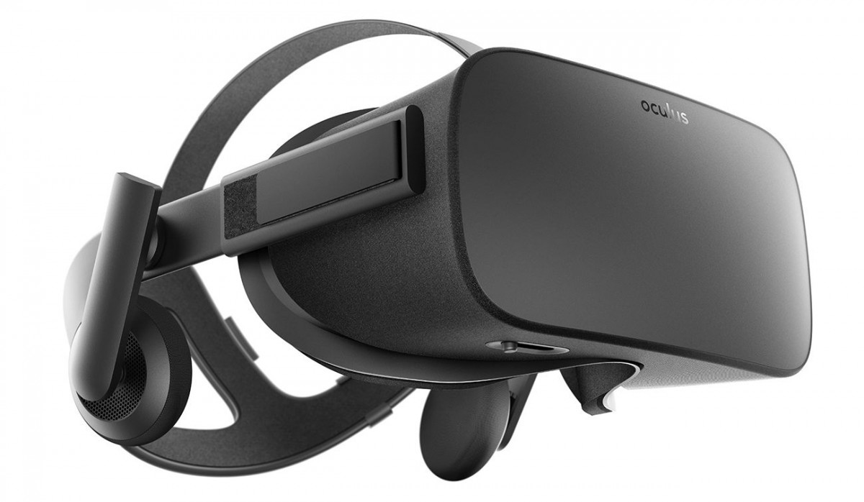
Oculus Rift
Cost: $399 USD
FOV: 110o Horizontal
Refresh rate: 90 Hz
Resolution 1080x1200/eye
3 DOF orientation tracking
3 axis positional tracking

Slide 24
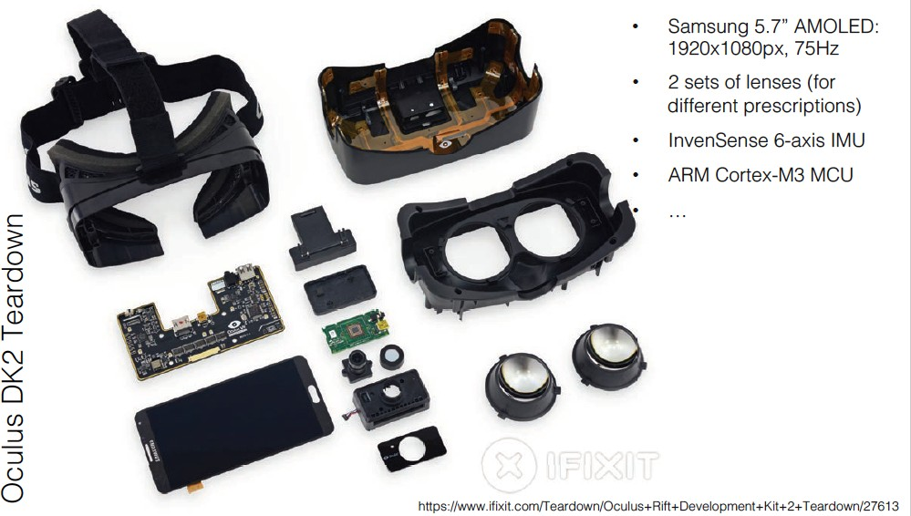
Inside an Oculus Rift

Slide 25
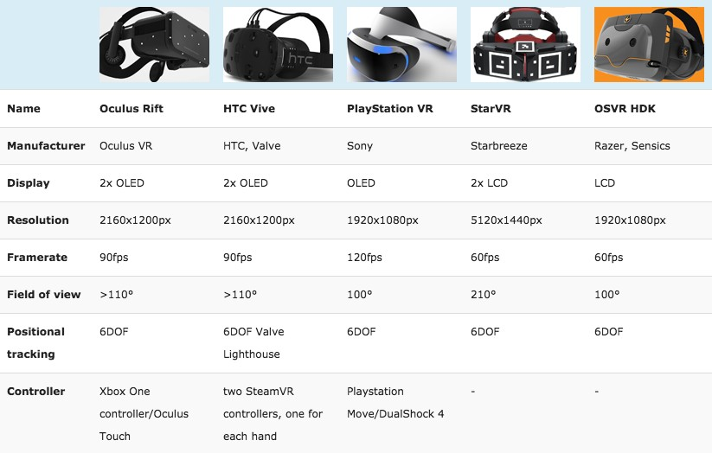
Comparison Between HMDs

Slide 26
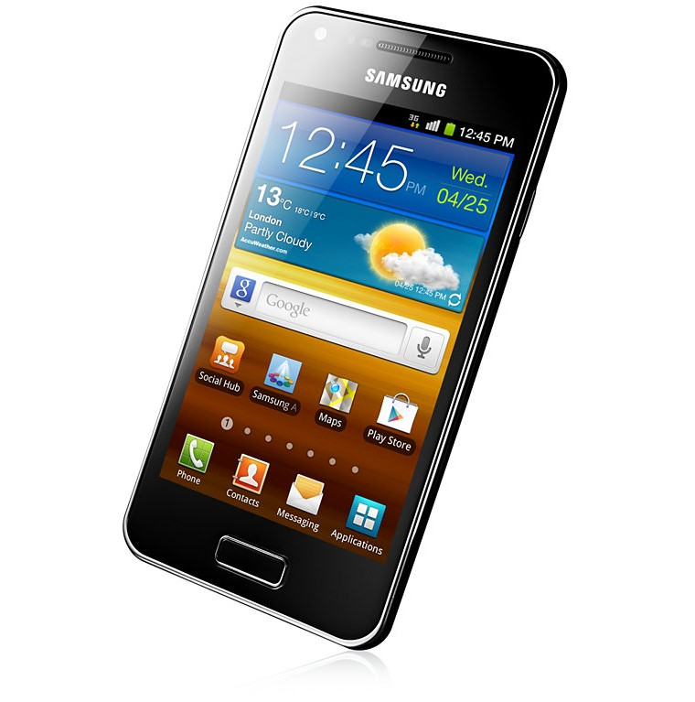
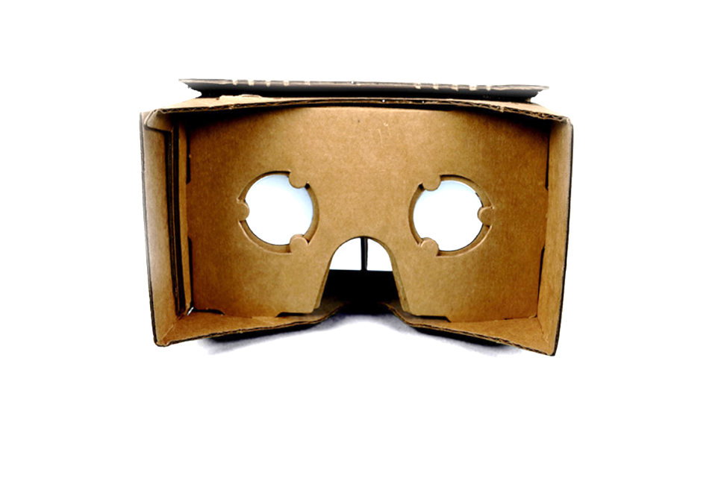
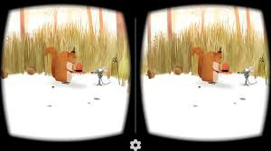
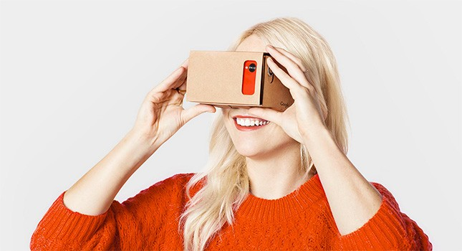
Mobile VR: Google Cardboard
Released 2014 (Google 20% project)
>5 million shipped/given away
Easy to use developer tools
+
=

Slide 27
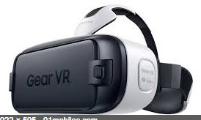
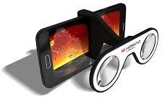
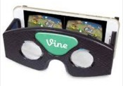
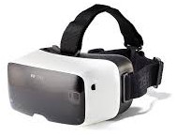
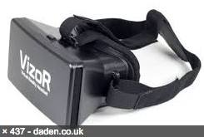
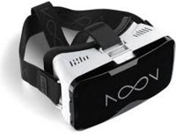
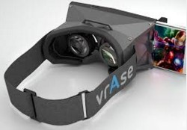
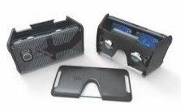
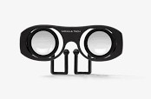
Multiple Mobile VR Viewers Available

Slide 28
Video see-through HMD
Video cameras
Video
Graphics
Monitors
Combiner

Slide 29
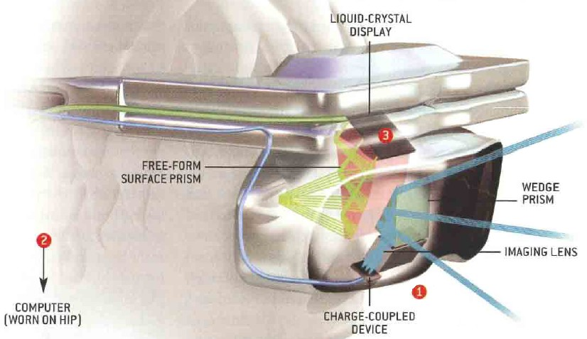
Video See-Through HMD

Slide 30
Example: Vive Pro
Resolution: 1440x1600 pixels per eye
2880x1600 pixels combined
Refresh rate: 90 Hz
Field of view: 110 degrees
https://www.vive.com/us/product/vive-pro/

Slide 31
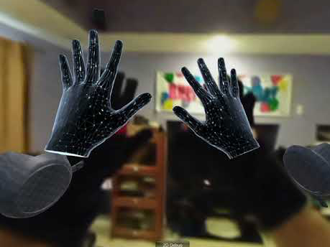
Vive Pro Video-Through Demo
https://youtu.be/yl44JFtDo0E

Slide 32
Optical see-through Head-Mounted Display
Virtual images from monitors
Real World
Optical Combiners

Slide 33
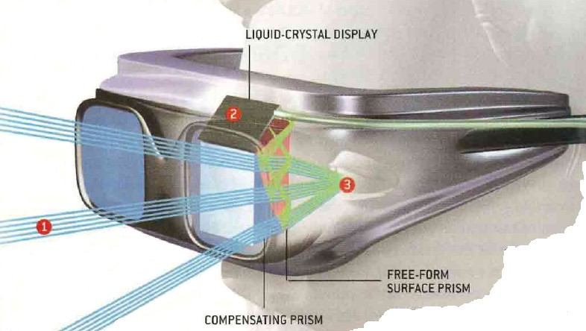
Optical See-Through HMD

Slide 34
Strengths of Video See-Through AR
True occlusion
AR pixels block video pixels
Digitized image of real world
Flexibility in composition
Matchable time delays
More registration, calibration strategies
Wide FOV is easier to support

Slide 35
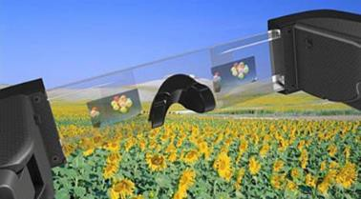
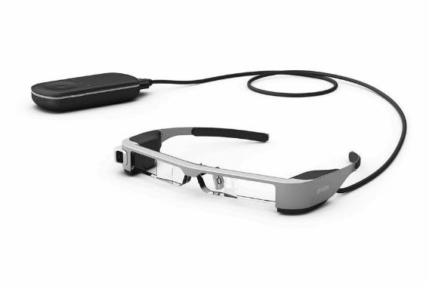
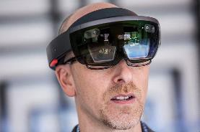
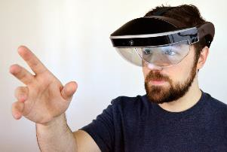
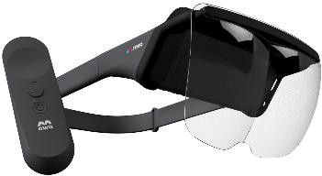
Optical See-Through Displays
Epson Moverio BT-300 - $700
1280 RGB x 720 pixels, 23 degree FOV, 30Hz, 69g
Android Powered, separate controller
VGA camera, GPS, gyro, accelerometer
https://epson.com/moverio-augmented-reality-smart-glasses-for-drone-flying
Microsoft HoloLens - $3,000 USD
Wearable computer
Waveguide displays
https://www.microsoft.com/hololens
Meta Meta2 - $1,500 USD
Wide field of view (90 degrees)
Tethered display
https://www.metavision.com/
Mira Prism - $100 USD
Smart phone based
Wide field of view
https://www.mirareality.com/

Slide 36
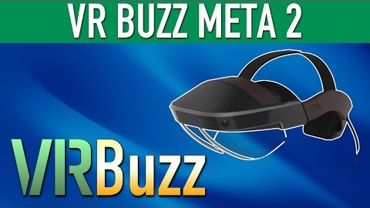
Example: Meta2
https://youtu.be/e1W29w63W4g

Slide 37
Strengths of Optical see-through AR
Simpler (cheaper)
Direct view of real world
Full resolution, no time delay (for real world)
Safety
Lower distortion
No eye displacement
but some video see-through displays avoid this

Slide 38
HUD-Type See-Through AR
Devices for monocular or bioccular display of information

Slide 39
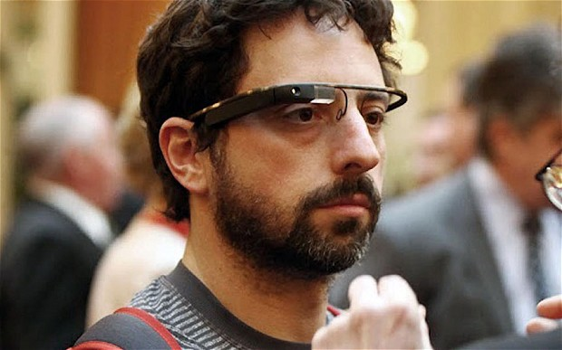
Example: Google Glass

Slide 40
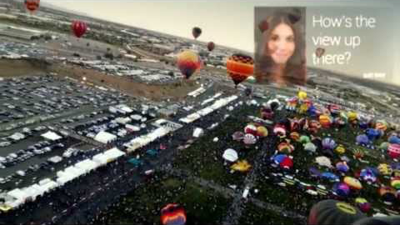
View Through Google Glass
https://youtu.be/zKNv505sYAM

Slide 41
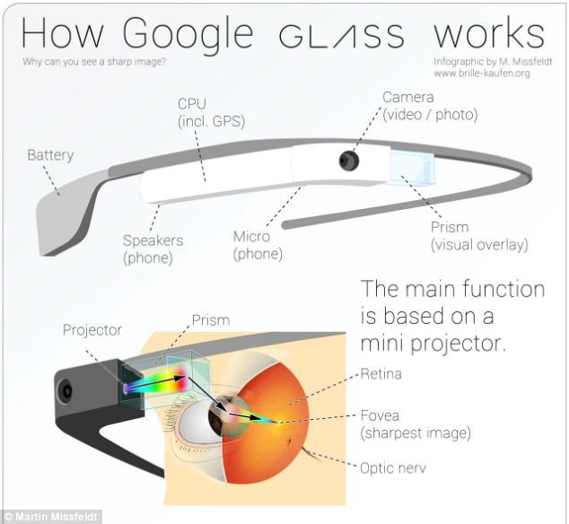

Slide 42


Display Technology
Curved Mirror
off-axis projection
curved mirrors in front of eye
high distortion, small eye-box
Waveguide
use internal reflection
unobstructed view of world
large eye-box

Slide 43

Example: Sony Waveguide Display
https://youtu.be/G2MtI7asLcA

Slide 44


See-through Thin Displays (Waveguide)
Waveguide techniques for thin see-through displays
Wider FOV, enable AR applications
Opinvent Ora
Lumus DK40

Slide 45

Example: Sony Smart EyeGlasses
https://youtu.be/kYPWaMsarss

Slide 46






Head Mounted Displays (HMD)
Positives
Display and Optics mounted on Head
Can be fully immersive
See-through HMDs can be used for AR
May or may not fully occlude real world
Provide full-color images
Negatives
Cumbersome to wear—bulky, heavy, obtrusive
Brightness
Tethering to computer or require low power consumption
Resolution limited—mismatch between accommodation/convergence; distortion at edges
Social acceptance?
Cost is high?
Adjustments: IPD, eye relief?
Eye glasses?

Slide 47


Comparison between Eyes and HMD
Human Eyes |  | HTC Vive
FOV | 200° x 135° | 110° x 110°
Stereo Overlap | 120° | 110°
Resolution | 30,000 x 20,000 | 2,160 x 1,200
Pixels/inch | >2190 (100mm to screen) | 456
Update | 60 Hz | 90 Hz
http://doc-ok.org/?p=1414
http://www.clarkvision.com/articles/eye-resolution.html
http://wolfcrow.com/blog/notes-by-dr-optoglass-the-resolution-of-the-human-eye/

Slide 48
Projection/Large Display Technologies
Conventional Projection
Room Scale Projection
CAVE, multi-wall environment, spherical display
Vehicle Simulator
Spatial Augmentation

Slide 49




Desktop VR
Also known as “fishtank” VR
Use computer monitor
Track head
Stereo from shutter glasses

Slide 50


Stereo Projection
Active Stereo
Active shutter glasses
Time synced signal
Brighter images
More expensive
Passive Stereo
Polarized images
Two projectors (one/eye)
Cheap glasses (powerless)
Lower resolution/dimmer
Less expensive

Slide 51


Displaying stereo
Passive/Polarization
Active/Shutter glasses

Slide 52



Z-screen
Display techniques for stereo viewing
But how do we present stereo images to the viewer?
Right eye should see right image only, same for left.
Otherwise ghosting (crosstalk) can appear.
Active stereo
Passive stereo

Slide 53


Polarized light
Circular polarization
Linear polarization

Slide 54
Passive systems
Pros
Cheap glasses, many viewers
Usually bright images (not much light is dropped, Max 60% left)
Cons
Not possible to rotate head when using linear polarization (solved with circular polarization)
Expensive projection surfaces (should not remove polarization)
bright projectors are required due to issue with light efficiency

Slide 55
Active systems
Pros
Usually better separation between eyes
Cons
Expensive glasses (does not scale to a large crowd)
Lower intensity, due to sequential image display technique
Generally, expensive
Bright projectors – about half of light is lost due to left/right switching glasses alone
Projectors must be capable of high refresh rates (120Hz) for active stereo

Slide 56


CAVE
Multi-walled stereo projection environment
Head tracked active stereo
Cruz-Neira, C., Sandin, D. J., DeFanti, T. A., Kenyon, R. V., & Hart, J. C. (1992). The CAVE: audio visual experience automatic virtual environment. Communications of the ACM, 35(6), 64-73

Slide 57

Typical CAVE Setup
4 sides, rear projected stereo images

Slide 58

Demo Video – Wisconsin CAVE
https://youtu.be/mBs-OGDoPDY

Slide 59





CAVE Variations

Slide 60

Caterpillar Demo
https://youtu.be/r9N1w8PmD1E

Slide 61

vision dome and other spherics

Slide 62


Vehicle Simulators
Combine VR displays with vehicle
Visual displays on windows
Motion base for haptic feedback
Audio feedback
Physical vehicle controls
Steering wheel, flight stick, etc
Full vehicle simulation
Emergencies, normal operation, etc
Weapon operation
Training scenarios

Slide 63

Demo: Boeing 787 Simulator
https://youtu.be/3iah-blsw_U

Slide 64



Spatial Augmented Reality
Project onto irregular surfaces
Geometric Registration
Projector blending, High dynamic range
Book: Bimber, Rasker “Spatial Augmented Reality”

Slide 65
Projector-based AR
User (possibly head-tracked)
Projector
Real objects
with retroreflective covering

Slide 66


Example of Projector-Based AR
Ramesh Raskar, MIT

Slide 67


Example of Projector-Based AR
Ramesh Raskar, MIT

Slide 68




Augmented Paleontology
Bimber et. al. IEEE Computer Sept. 2002

Slide 69

CastAR (now defunct)
Stereo head worn projectors
Interactive wand
Rollable retro-reflective sheet

Slide 70

Demo: CastAR
https://youtu.be/AOI5UW9khoQ?t=47

Slide 71

Workbench / MR Tabletops

Slide 72


Pain points with projection VR
Alignment matters
for stereo setups, especially passive stereo, alignment is crucial
for tile-able displays with high resolution
images must overlap and blend
Actually, should be able to project on any surface
large set of research devoted to
automatic alignment
image blending, color matching
projection onto arbitrary surfaces (not just flat walls)

Slide 73

Autostereoscopic displays

Slide 74


Volumetric displays
Perspecta by Actuality Systems
Used rotating screen

Slide 75



“Handheld” Displays
Tablet
Laptop
Mobile Phone

Slide 76


Phones and Tablets
Largest segment of the available devices
Contain “everything” you need—display, camera, microphone, speaker, tracking
Device variation makes product consistency difficult (requires calibration and special accommodations)

Slide 77
Which visual display to use?
Consider lists of pros and cons
Consider depth cues supported
Consider level of visual immersion
But this is a very hard question to answer empirically
Instead of comparing actual displays, compare levels of immersion

